Slide 1
Having a Successful Video

Slide 2
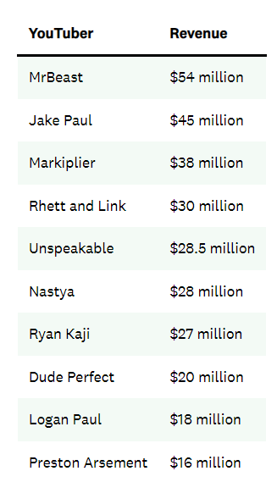
Why?
2.5B
monthly active users
47%
of global internet traffic
Goal: How do you make a successful Youtube Video?
Notes:
Start: Now, why do I want to talk about having a successful Youtube Video? Well, there are multiple factors why this is something that is becoming more and more important in the culture around the world. To start, Youtube (click) is a very popular platform that has 2.49 Billion Active Users and accumulates over 47% of the Global Internet Traffic. This shows that there are lot of eyes on youtube, with a lot of eyes on social media platforms, there generally comes a lot of money due to advertising revenue. And, (click), as you can see here, there are a lot of possibilities for the amount of money to be made from Youtube.

Slide 3
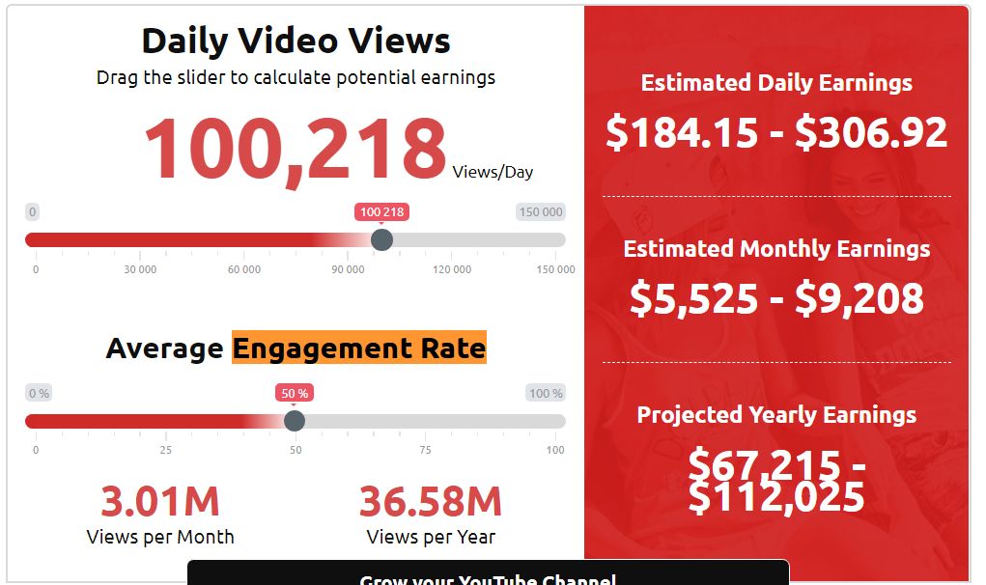
Measuring Video Success
Success: Video over 100k views
Notes:
Now, for this project, how am I measuring success? According to influencermarketinghub (click), 100,000 daily views can earn you anywhere from 68k-112k with 50% of people clicking on ads. This can be enough to make a living off of.

Slide 4
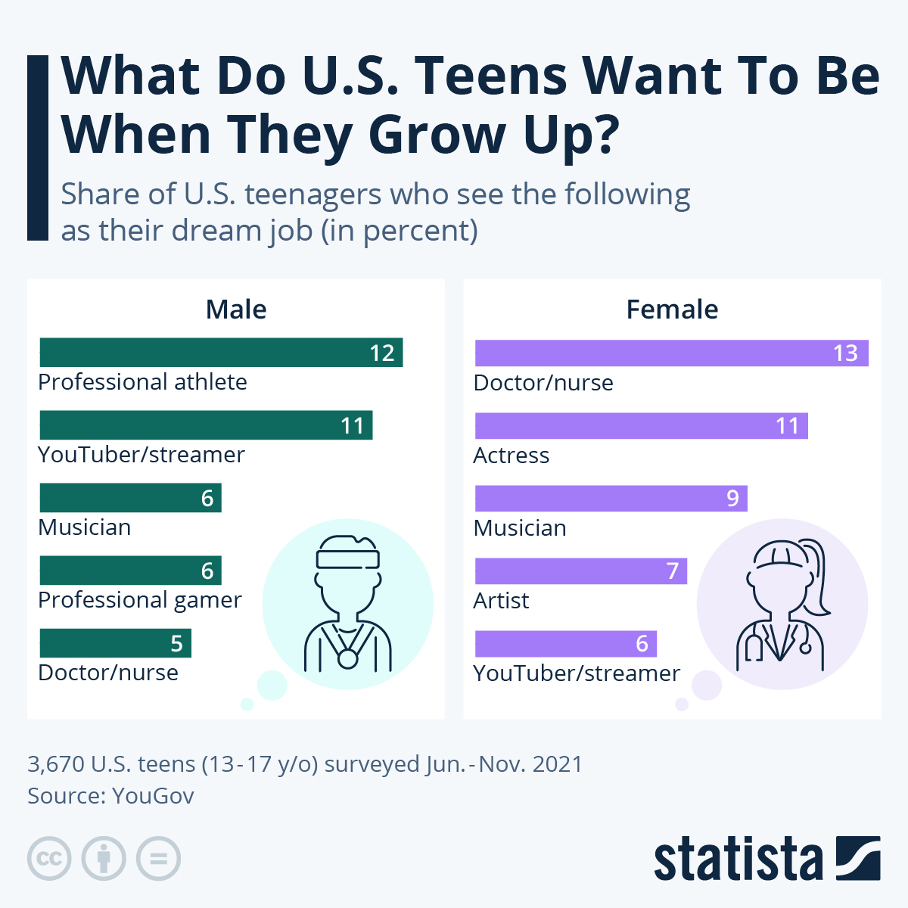
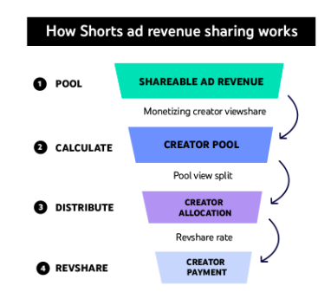
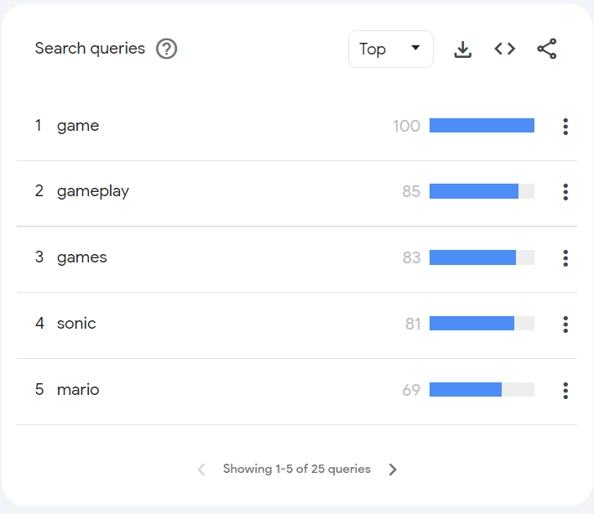
Data Set Used
Gaming Related Videos
January 29th-Feb 5th 2024
Videos Targeted to the US
Collected Videos of Varying Lengths on varying days
No Shorts
Searched for Videos based on trending terms in YouTube
Notes:
Because there are little kids, particularly boys, that want to be Youtube/streamers AND professional gamers, I decided to curtail my data to Gaming. I also decided to minimize the amount of videos selected to a week. I decided on this week because, when collecting the data there were two-three weeks in between me collecting the data and the videos gaining views. Usually Videos have there most views within the first day and then usually stay stagnant after one week. I wanted the data to be current enough so it made sense but didn’t want it to be too recent so the numbers fluctuated when collecting them. I also decided to stick with videos that are targeted to the US because the US is the second biggest market for Youtube. I decided on not collecting shorts due to shorts having a completely different monetization strategy. I also decided to get videos with varying lengths or videos that are “Short” (0-4 Mins), “Medium” (4-20 mins), Long (20+ Mins). This will allow be to get a variety of lengths. I also used the Search API to get videos to search for queries that were trending (words like Mario, game, tekken 8, which is a game that just came out, pokemon, roblox, etc.). Used the Google Trends Page to see what words were trending and rotated through search terms to find the videos

Slide 5
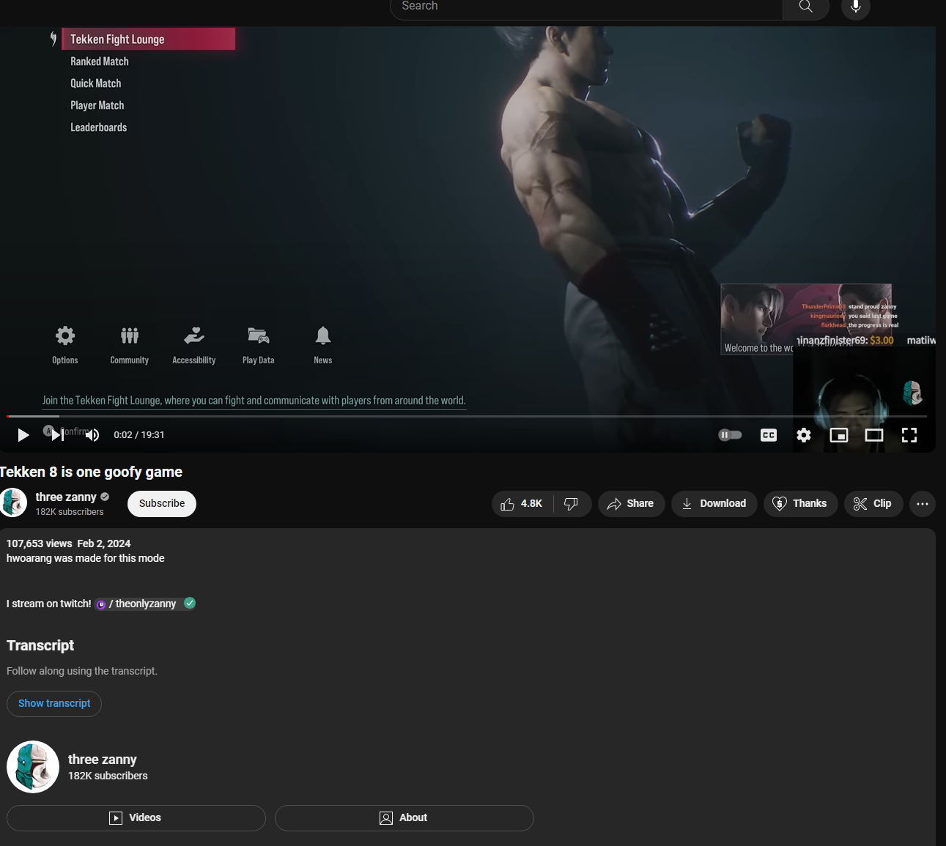
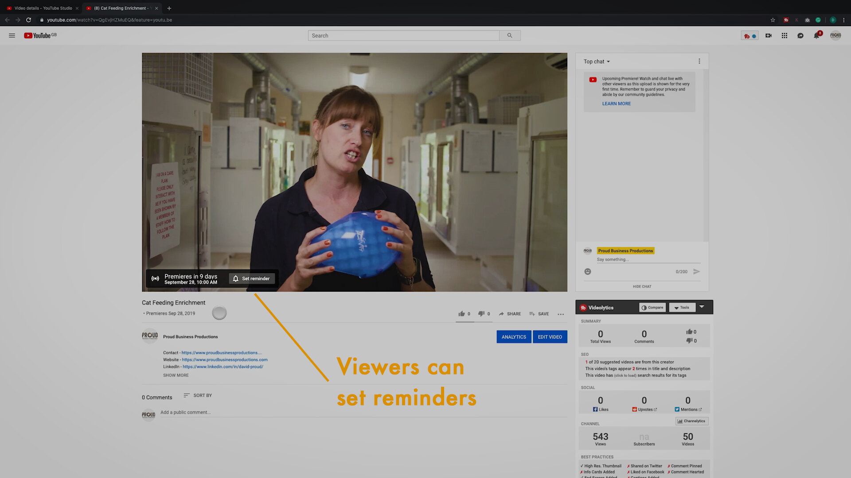
Video Features Explored
Audience Engagement
Did people like this video and past videos?
Video Characteri
Trending
Using buzzwords/playing popular games
Video Quality
Is your video hd? Is it 2d or 3d?
Video Characteristic
How long was the video? Was it licensed?
Self Promotion
Did you use Social Media to promote yourself?
Searchability
Did you use video tags? How many tags did you use?Video Characteri
Launch Process
When was the video published?
How was it published?
Video Characteri
Notes:
Audience Engagement:

Slide 6
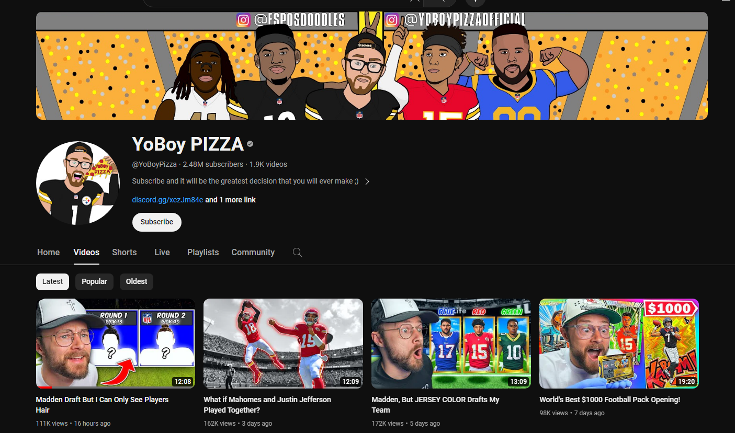
Channel Features Explored
Consistency
How often do you post?
Video Characteristic
Established Audience
Subscriber Count
Views Per Video in last 3 Months
Intended Audience
Channel is Made for Kids?
Do they have some videos Made for Kids?
Channel Characteristics
Channel Age
Channel Published Date
Notes:
Consistency measures how many videos they posted from November to January. The idea being the more videos you post the more views you get.
Established Audience is the amount of views in the past along with Sub count
Intended Audience is related to kids

Slide 7
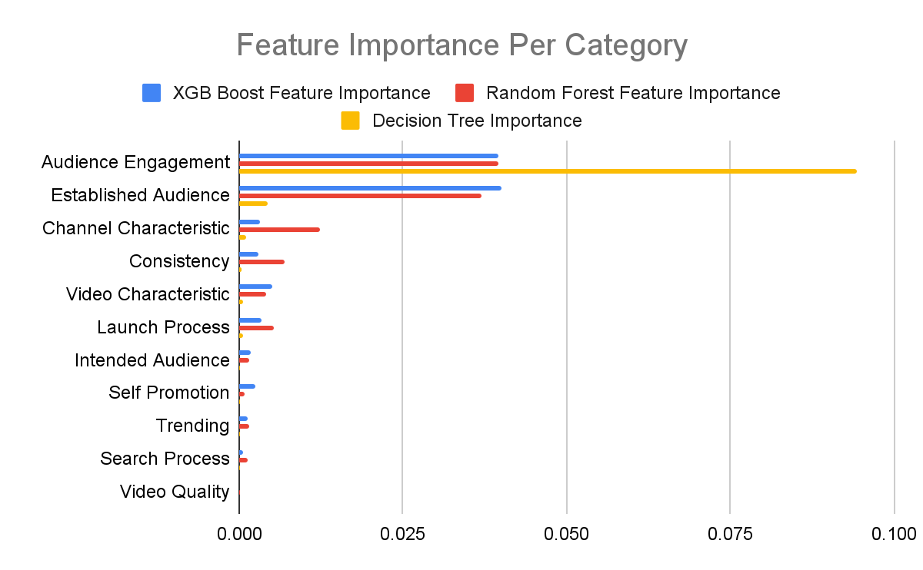
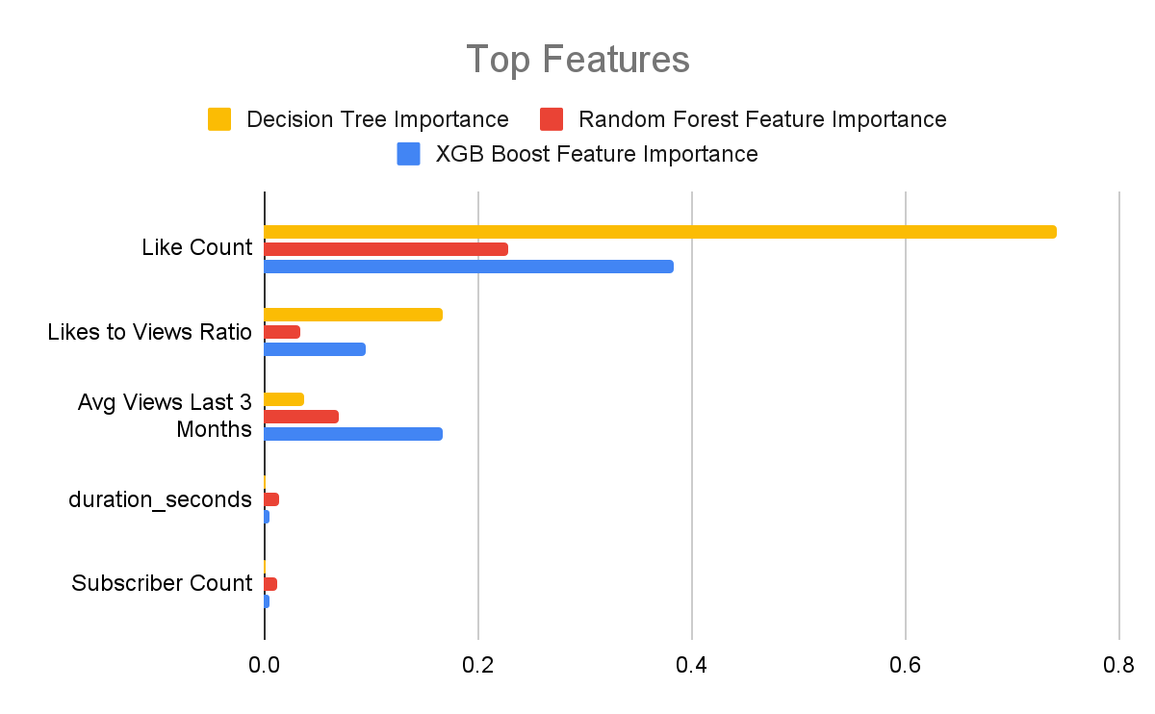
Model Features
Notes:
If I were to use all features, this shows the importance per category. I averaged the feature importance per category to show what matters more. This shows that Video Quality is not very important to views. It also shows tags are not very important on average but may have small use. Having an audience engagement and established audience matters. This shows in the top features where the top 2 are related to audience engagement. Likes to Views Ratio is the idea of diving likes by views. This gives you an idea if people like a video. A higher ratio ideally leads to more views. This also shows how each model prioritizes features. For example, worries me a little for Decision tree on how much it

Slide 8
Model: Precision + ROC AUC
 |  | Precision |  |  | ROC AUC
Name | Feature Count | Decision Tree | Random Forest | XGB Boost | Decision Tree | Random Forest | XGB Boost
Top Two Important Features from each category (XGB Boost) | 16 | 98.28% | 98.52% | 98.27% | 99.10% | 97.24% | 98.76%
Top Two Important Features from each category (Decision Tree) | 15 | 97.68% | 98.25% | 98.64% | 98.94% | 96.33% | 99.00%
Tweaking 2 Important Features from Decision Tree | 10 | 97.32% | 98.46% | 98.27% | 98.86% | 97.98% | 99.03%
Notes:
I tried a bunch of different models. I tried using the top features from each grouping (except for Search Process and Video Quality) to have a more balanced model and make sure all the important parts were captured. I tried using the top coefficient per category and found that it was too little data. When I used the top two important features from each category, I saw better results.Then I tried getting similar results by taking some features away and seeing where I could improve. In the model I am trying to use, I used the default settings for each and tried to see what had the best precision and ROC AUC. I prioritized those metrics because if I predict it is a 100k video incorrectly, that could lead to money lost and lead to someone potentially not being able to make a living from youtube. This is why I also wanted distinct classes, hence why I valued Area Under the Curve because, if I predict something incorrectly, that could again, lead to someone not making a lively hood.
Top Two Important Features from Each Category (XGB Boost): Like Count, Likes to Views Ratio, Video Licensed Code, Premier Stream Video, Country Code, Time of Day, Top Selling Game 2024, Links Twitter, Channel Made for Kids, Amount of Tags, Channel Age, Tags Exist, Video Definition, Links Twitch, Links Instagram, Video Projection
Top Two Important Features from each category (Decision Tree): Like Count, Likes to Views Ratio, duration_seconds, Links Instagram, Game Played, Hour, Channel Age, Country Code, Channel Made For Kids, Amount of Tags, Day of Week Code, Made for Kids, Video Definition Code, Video Projection Code, Video Dimension Code
Tweaking 2 Important Features From Decision Tree: Like Count, Likes to Views Ratio, Avg Views Last 3 Months, Premier Stream Video, Video Licensed, Primary Social Media Link, duration_seconds, Game Played, Time of Day

Slide 9
Model: Choosing Model + Metrics
Feature Set Name | Model Used | Amount of Features | Precision | ROC AUC | Recall | F1 Score
Top Two Important Features from each category (XGB Boost) | Decision Tree | 16 | 98.28% | 99.10% | 98.28% | 98.28%
Top Two Important Features from each category (Decision Tree) | XGB Boost | 15 | 98.64% | 99.00% | 98.05% | 98.35%
Tweaking 2 Important Features from Decision Tree | XGB Boost | 10 | 98.27% | 99.03% | 98.13% | 98.20%
Model Chosen:
Tweaking 2 Important Feature from Decision Tree is Chosen
Less Features
Similar Scores to the Other Models
Balanced Feature Set
Notes:
Less Features makes it more simplistic and improves the computational efficiency. I also want to enhance the robustness to variations. It also has not far from the scores from the other two. It still keeps a balanced feature set by including most of the categories

Slide 10
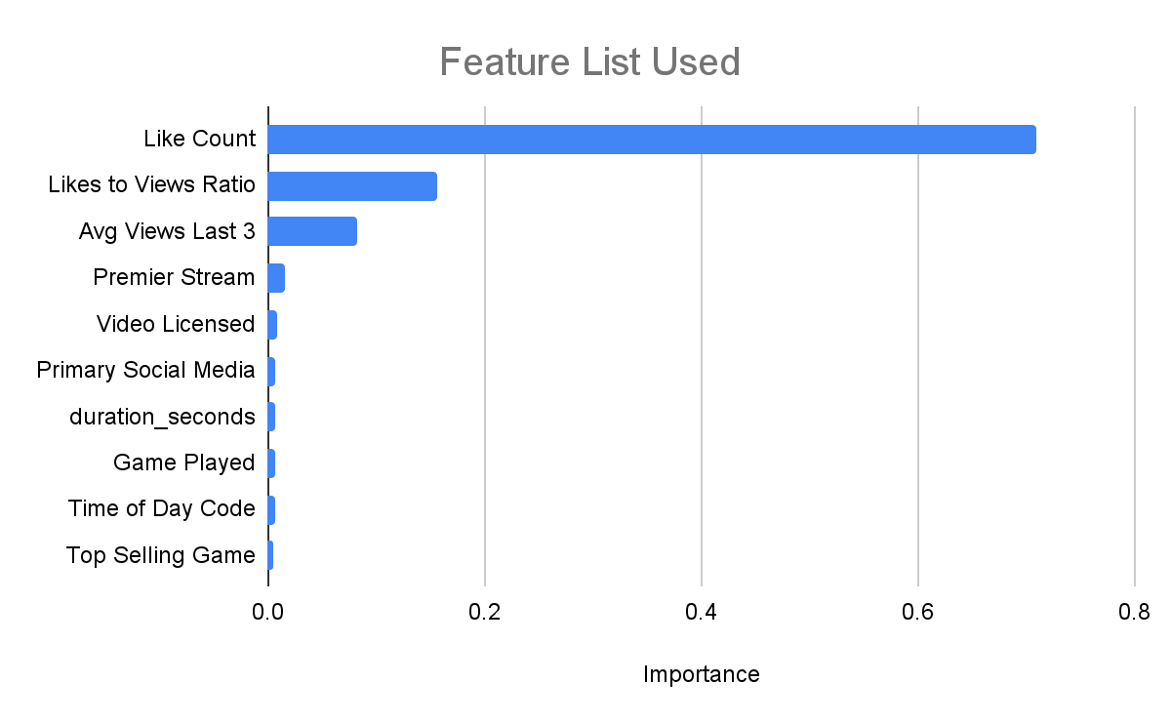
Model: Final Metrics
Precision
98.57%
ROC AUC
99.98%
Recall
98.35%
F1 Score
98.46%
Notes:
params = {
'colsample_bytree': 1.0, #Sampling each and every feature for all samples
'gamma': 0, #Essentially no regularization being used
'learning_rate': 0.2, #Because it is a lower value, it makes the model more robust by shrinking the weights on each step
'max_depth': 5, #5 decisions are made before it comes to a conclusion on if the video will be higher/lower than 100k views
'min_child_weight': 2, #Each child must have 2 instances. This will hopefully prevent overfitting
'reg_alpha': 0, # no L1 regularization is applied to the weights of the model.
'reg_lambda': 0.5,#a moderate level of L2 regularization. It strikes a balance between preventing overfitting and allowing the model to learn from the data effectively.
'subsample': 1.0 #All samples are being used to validate the model
}

Slide 11
Conclusion + Improvements
Conclusions
Likes + Past Views Play a Large role into understanding if a video is good
How to License a Video Should be Learned about due to resulting in more views
Premier or Stream Needs to be explored as to when it would be good to use
Other features need to be explored in how they should be used
Improvements
Do Good Thumbnails Matter
Does playing different games over time impact views?
Can Mic Quality clearly be measured?
Can video information be picked up quicker?
Does the amount of ads placed impact people watching a video?
 | Video Count | AVG View Count
Has Video License | 104443 | 4136
Does not have Video License | 58347 | 62242
 | Video Count | AVG View Count
Premier Function Used | 13005 | 9489
Stream | 20732 | 6933
Video | 129053 | 29419
Notes:
Premier Social Media Link: 10k views better than not having one; 5-10 mins seems to have the best views;

Slide 12
Links
Code

